Slide 1


Series solution: power series
REDUCEABLE TO SEPARABLE (HOMOGENEOUS EQUATION)

Slide 2
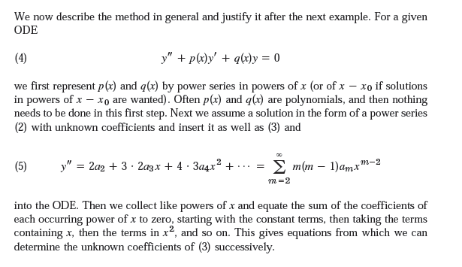


Slide 3
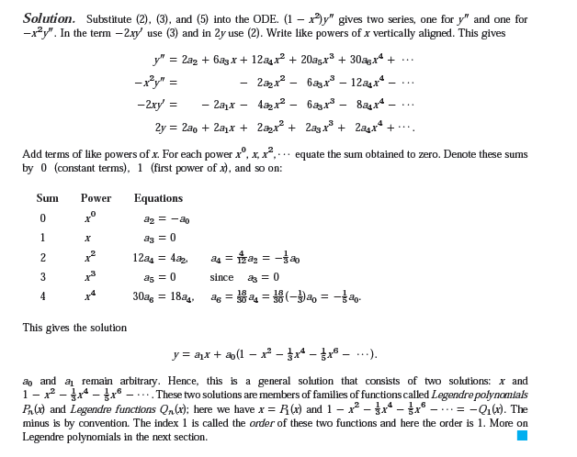

Slide 4
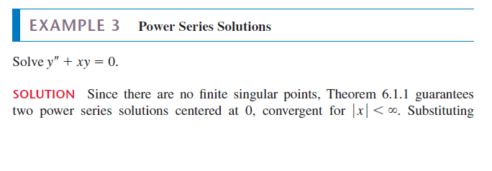

Slide 5
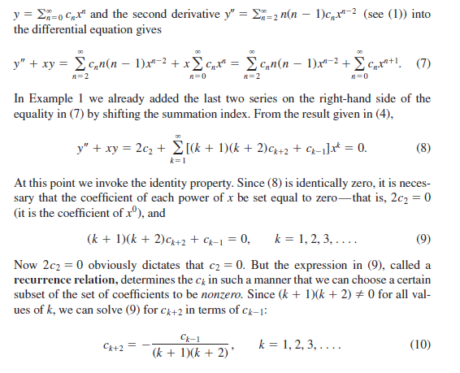

Slide 6
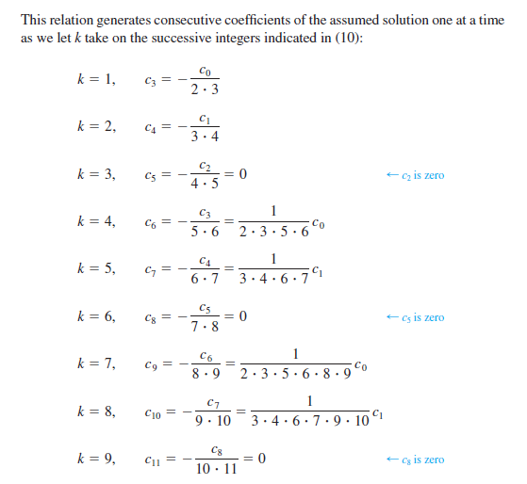

Slide 7

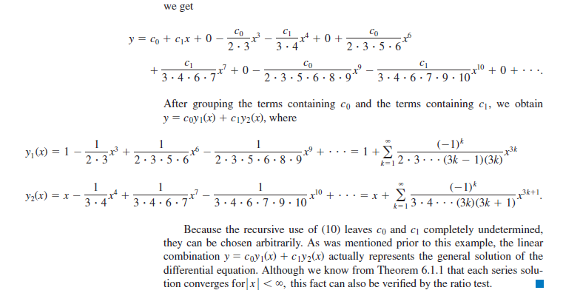

Slide 8
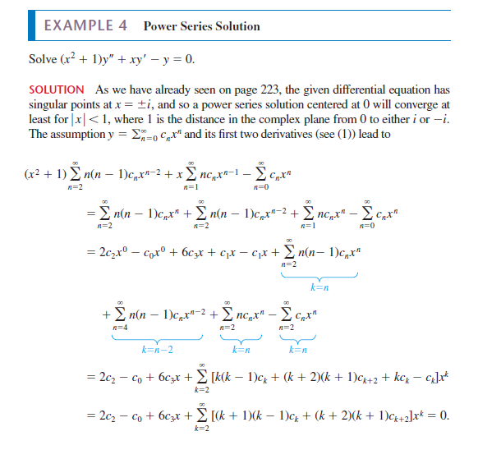

Slide 9
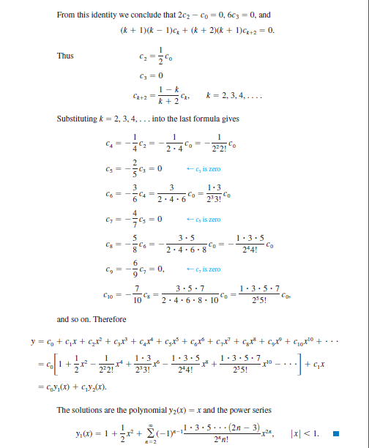

Slide 10
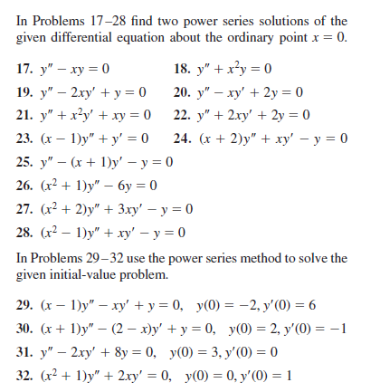

Slide 11


Slide 12




Slide 13


Slide 14



Slide 15



Slide 16



Slide 17


Slide 18




Slide 19


